Slide 1



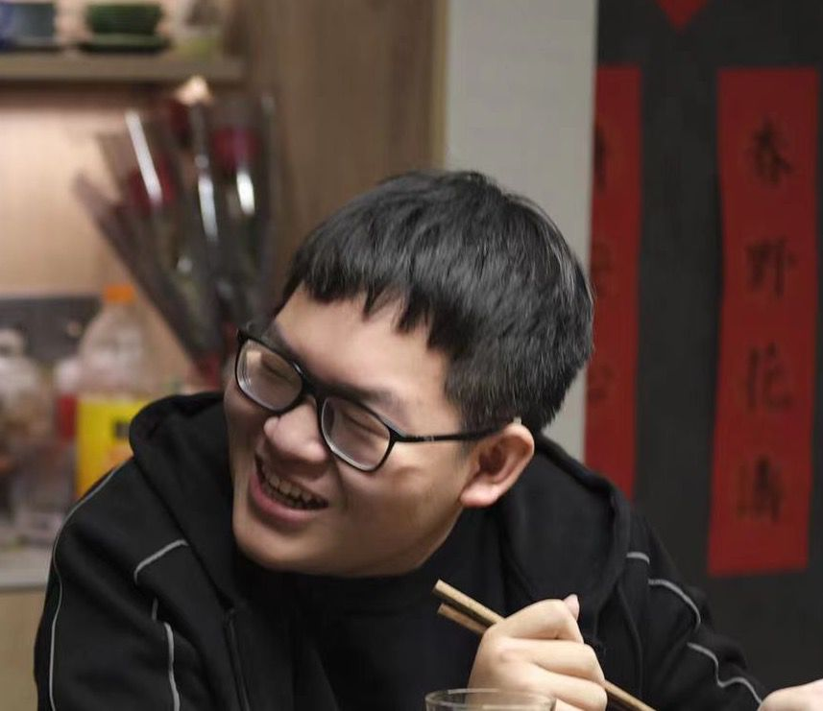

Novelty Detection using GANs
Group：Keyang Qian (left), Ke Ran (middle), Ruofan Yang (right)
Lecturer: Keyang Qian
延时符

Slide 2
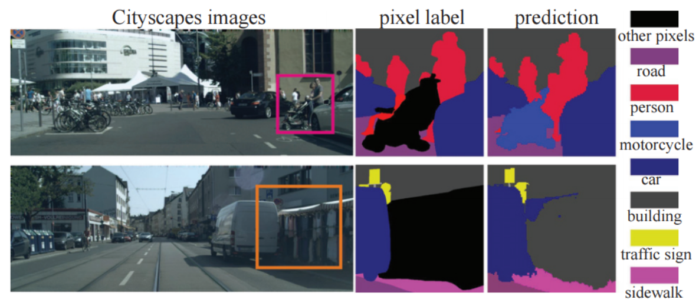
Scenario
Such misclassifications can be a critical mistake when fed into auto-vehicle agents! Image retrieved from OpenGAN: Open-Set Recognition via Open Data Generation

Slide 3
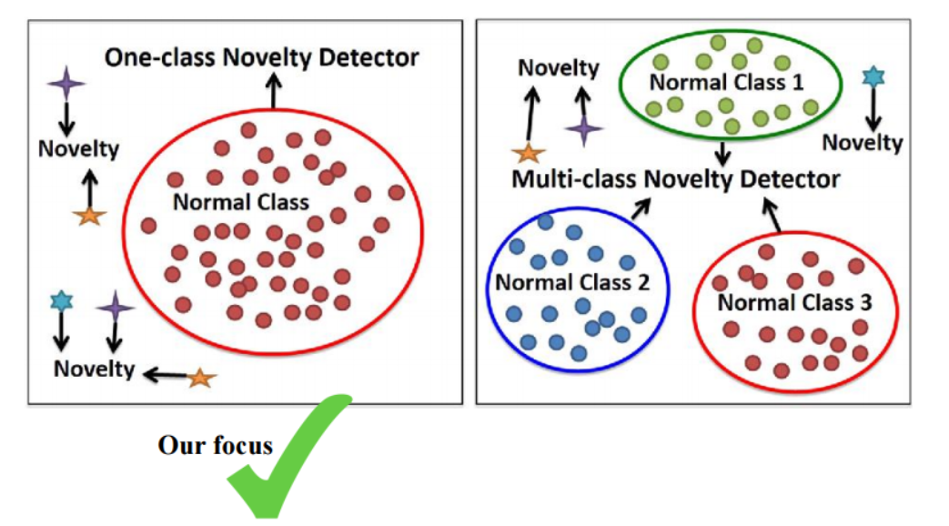
Research Question
Image retrieved from https://github.com/khalooei/ALOCC-CVPR2018

Slide 4
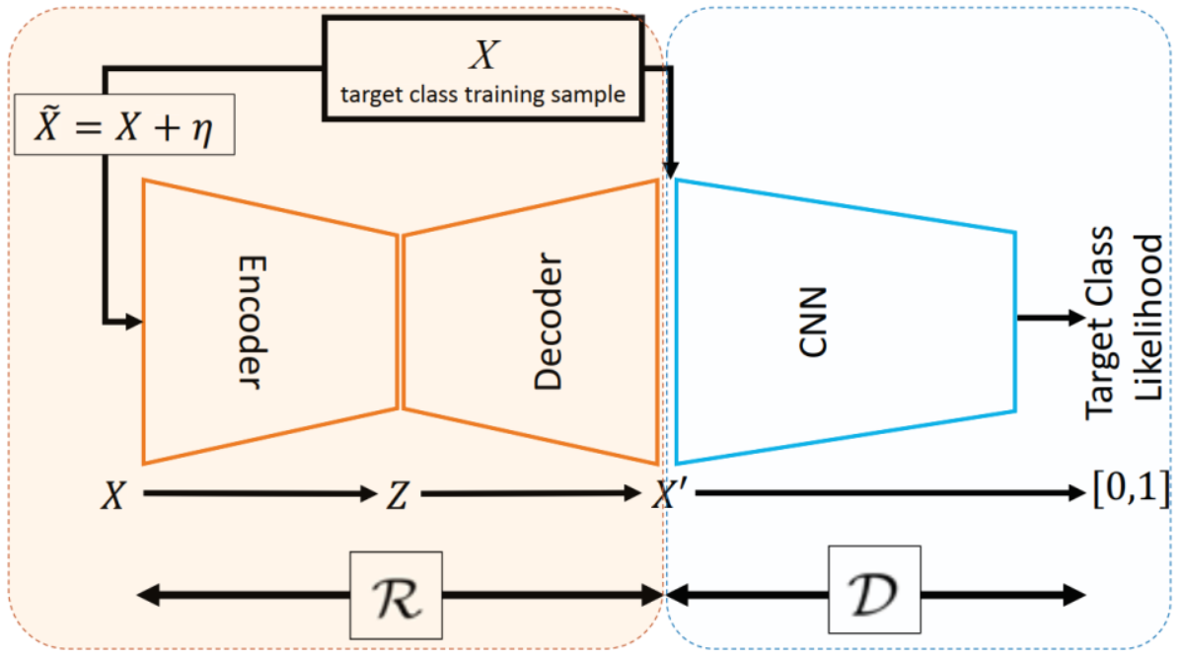
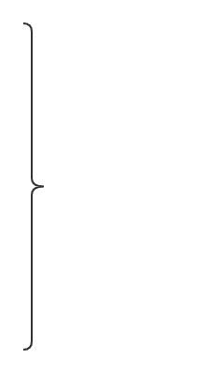
Approach & Ideas
Ideas:
Wasserstein GAN
Concatenation;
Residual
connection;
GAN training tricks;
Combinations methods of networks;
etc. shared on May 20!
Generative Adversarial Network (GAN)
Image retrieved from Adversarially Learned One-Class Classifier for Novelty Detection

Slide 5
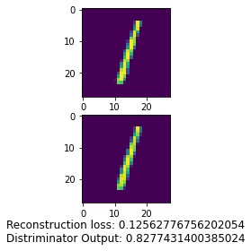
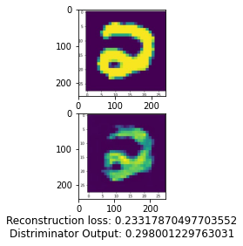
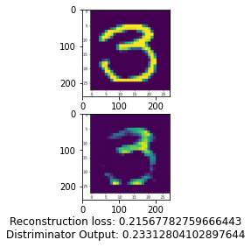
Partial Results
Seems satisfying in MNIST? What about others?
Is there a universal model structure?
Discuss on May 20!
inlier
outlier
outlier

